Slide 1
Chapter 2
Instructions: Language of the Computer
Notes:
The University of Adelaide, School of Computer Science
Chapter 2 — Instructions: Language of the Computer

Slide 2
Instruction Set
§2.1 Introduction
The repertoire of instructions of a computer
Different computers have different instruction sets
  But with many aspects in common
Early computers had very simple instruction sets
  Simplified implementation
Many modern computers also have simple instruction sets
Chapter 2 — Instructions: Language of the Computer — <number>
Notes:
The University of Adelaide, School of Computer Science
Chapter 2 — Instructions: Language of the Computer

Slide 3
The MIPS Instruction Set
Used as the example throughout the book
Stanford MIPS commercialized by MIPS Technologies (www.mips.com)
Typical of many modern ISAs
  See MIPS Reference Data tear-out card, and Appendixes B and E
Similar ISAs have a large share of embedded core market
  Applications in consumer electronics, network/storage equipment, cameras, printers, …
Chapter 2 — Instructions: Language of the Computer — <number>
Notes:
The University of Adelaide, School of Computer Science
Chapter 2 — Instructions: Language of the Computer

Slide 4
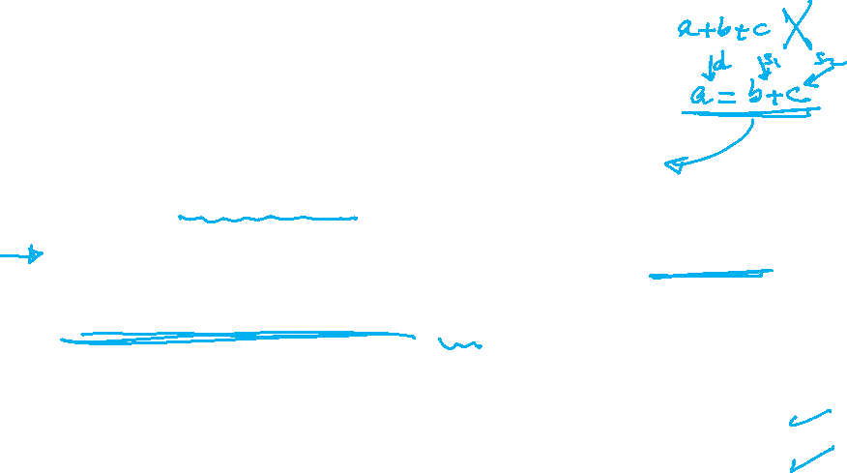
Arithmetic Operations
Add and subtract, three operands
  Two sources and one destination
add a, b, c # a gets b + c
All arithmetic operations have this form
Design Principle 1: Simplicity favors regularity
  Regularity makes implementation simpler
  Simplicity enables higher performance at lower cost
§2.2 Operations of the Computer Hardware
Chapter 2 — Instructions: Language of the Computer — <number>
Notes:
The University of Adelaide, School of Computer Science
Chapter 2 — Instructions: Language of the Computer

Slide 5
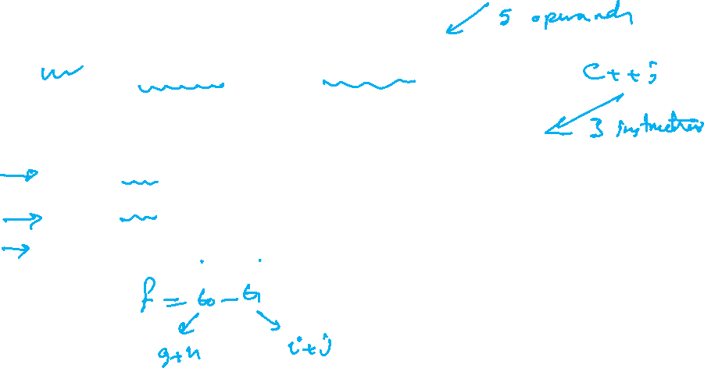
Arithmetic Example
C code:
f = (g + h) - (i + j);
Compiled MIPS code:
add t0, g, h # temp t0 = g + h
add t1, i, j # temp t1 = i + j
sub f, t0, t1 # f = t0 - t1
Chapter 2 — Instructions: Language of the Computer — <number>
Notes:
The University of Adelaide, School of Computer Science
Chapter 2 — Instructions: Language of the Computer

Slide 6
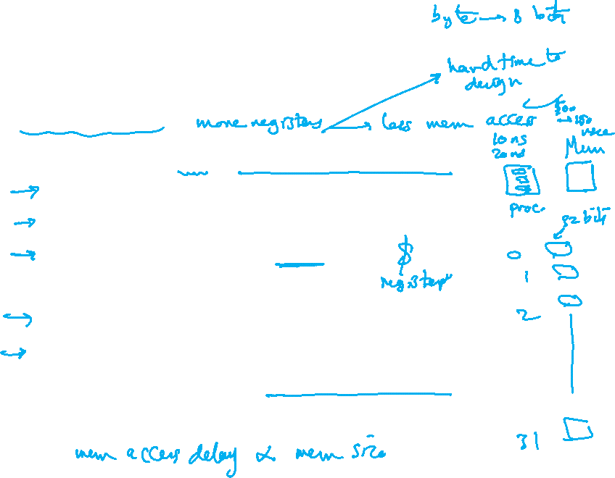
Register Operands
Arithmetic instructions use register
operands
MIPS has a 32 × 32-bit register file
  Use for frequently accessed data
  Numbered 0 to 31
  32-bit data called a “word”
Assembler names
  $t0, $t1, …, $t9 for temporary values
  $s0, $s1, …, $s7 for saved variables
Design Principle 2: Smaller is faster
  c.f. main memory: millions of locations
§2.3 Operands of the Computer Hardware
Chapter 2 — Instructions: Language of the Computer — <number>
Notes:
The University of Adelaide, School of Computer Science
Chapter 2 — Instructions: Language of the Computer

Slide 7
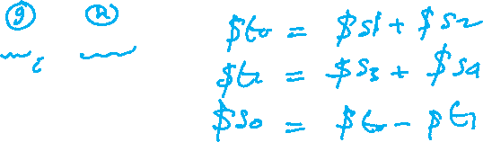
Register Operand Example
C code:
f = (g + h) - (i + j);
  f, …, j in $s0, …, $s4
Compiled MIPS code:
add $t0, $s1, $s2
add $t1, $s3, $s4
sub $s0, $t0, $t1
Chapter 2 — Instructions: Language of the Computer — <number>
Notes:
The University of Adelaide, School of Computer Science
Chapter 2 — Instructions: Language of the Computer

Slide 8
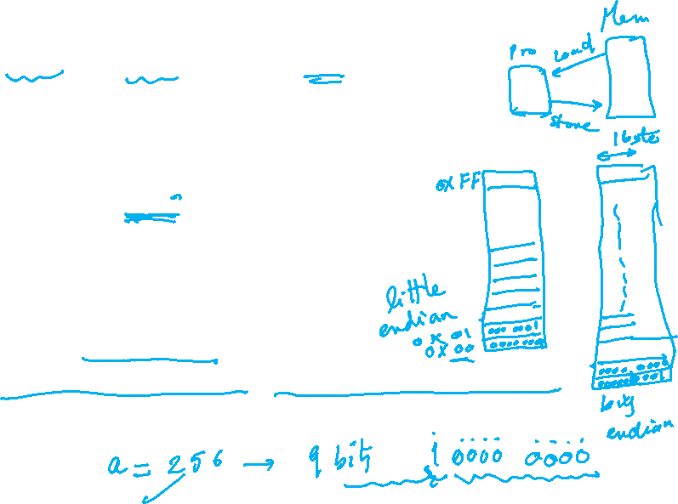
Memory Operands
Main memory used for composite data
  Arrays, structures, dynamic data
To apply arithmetic operations
  Load values from memory into registers
  Store result from register to memory
Memory is byte addressed
  Each address identifies an 8-bit byte
Words are aligned in memory
  Address must be a multiple of 4
MIPS is Big Endian
  Most-significant byte at least address of a word
  c.f. Little Endian: least-significant byte at least address
Chapter 2 — Instructions: Language of the Computer — <number>
Notes:
The University of Adelaide, School of Computer Science
Chapter 2 — Instructions: Language of the Computer

Slide 9
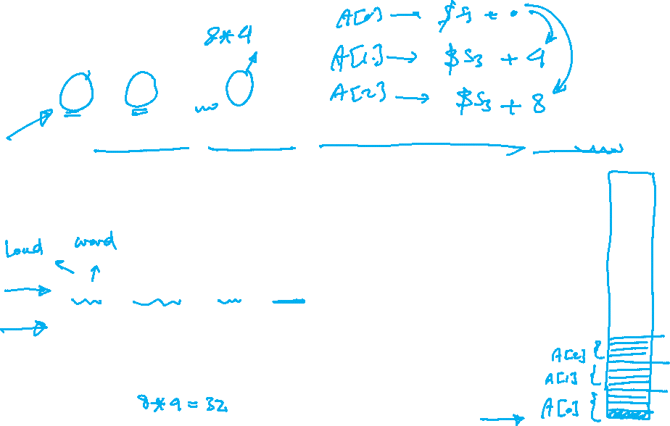
Memory Operand Example 1
C code:
g = h + A[8];
  g in $s1, h in $s2, base address of A in $s3
Compiled MIPS code:
  Index 8 requires offset of 32
    4 bytes per word
lw $t0, 32($s3) # load word
add $s1, $s2, $t0
offset
base register
Chapter 2 — Instructions: Language of the Computer — <number>
Notes:
The University of Adelaide, School of Computer Science
Chapter 2 — Instructions: Language of the Computer

Slide 10
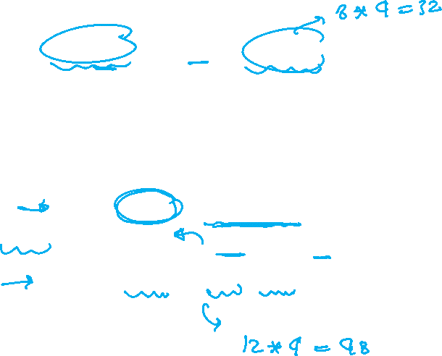
Memory Operand Example 2
C code:
A[12] = h + A[8];
  h in $s2, base address of A in $s3
Compiled MIPS code:
  Index 8 requires offset of 32
lw $t0, 32($s3) # load word
add $t0, $s2, $t0
sw $t0, 48($s3) # store word
Chapter 2 — Instructions: Language of the Computer — <number>
Notes:
The University of Adelaide, School of Computer Science
Chapter 2 — Instructions: Language of the Computer

Slide 11
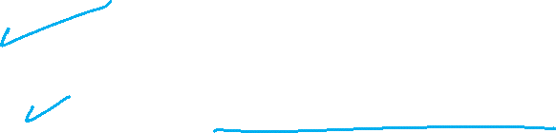
Registers vs. Memory
Registers are faster to access than memory
Operating on memory data requires loads and stores
  More instructions to be executed
Compiler must use registers for variables as much as possible
  Only spill to memory for less frequently used variables
  Register optimization is important!
Chapter 2 — Instructions: Language of the Computer — <number>
Notes:
The University of Adelaide, School of Computer Science
Chapter 2 — Instructions: Language of the Computer

Slide 12
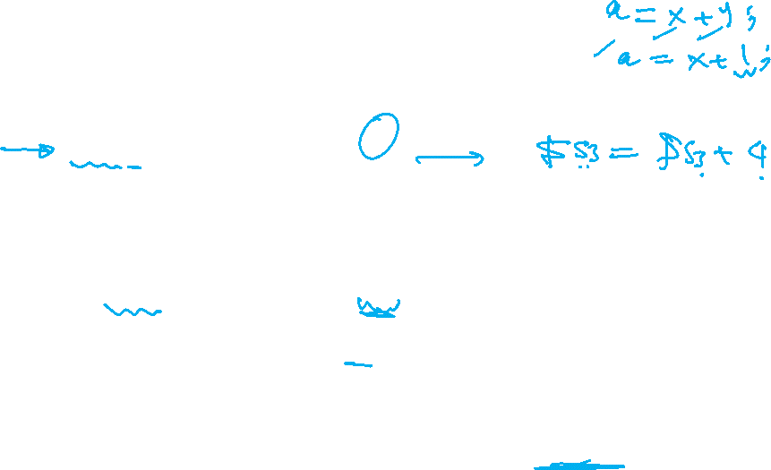
Immediate Operands
Constant data specified in an instruction
addi $s3, $s3, 4
No subtract immediate instruction
  Just use a negative constant
  addi $s2, $s1, -1
Design Principle 3: Make the common case fast
  Small constants are common (50% in SPEC benchmark)
  Immediate operand avoids a load instruction
Chapter 2 — Instructions: Language of the Computer — <number>
Notes:
The University of Adelaide, School of Computer Science
Chapter 2 — Instructions: Language of the Computer

Slide 13
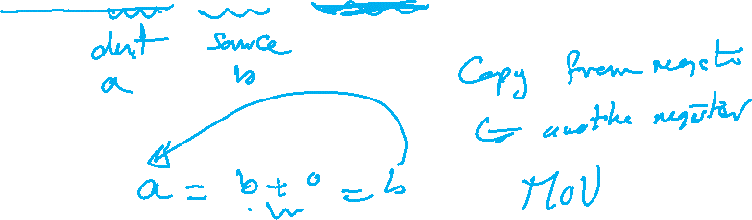
The Constant Zero
MIPS register 0 ($zero) is the constant 0
  Cannot be overwritten
Useful for common operations
  E.g., move between registers
  add $t2, $s1, $zero
Chapter 2 — Instructions: Language of the Computer — <number>
Notes:
The University of Adelaide, School of Computer Science
Chapter 2 — Instructions: Language of the Computer

